Slide 1
Virologic efficacy of raltegravir vs. efavirenz based antiretroviral treatment in HIV1-infected adults with tuberculosis W48 results of the ANRS 12300 Reflate TB2 trial
N. De Castro¹, O. Marcy², C. Chazallon², E. Messou³, S. Eholie⁴, N. Bhatt⁵, C. Khosa⁵, D. Laureillard⁶,
G. Do Chau⁷, V. Veloso⁸, C. Delaugerre^{1,9}, X. Anglaret², JM. Molina^{1,9}, B. Grinsztejn⁸
for the ANRS 12300 Reflate TB2 study group
¹ AP-HP-Hôpital Saint-Louis, Paris, France, ²University of Bordeaux, Bordeaux Population Health Centre Inserm U1219, Bordeaux, France, ³CEPREF, Abidjan, Cote D'Ivoire, ⁴SMIT, Abidjan, Cote D'Ivoire, ⁵Instituto Nacional de Saúde, Maracuene, Mozambique, ⁶CHU de Nîmes, Nîmes, France, ⁷Pham Ngoc Thach Hospital, Ho Chi Minh City, Vietnam, ⁸Laboratory of Clinical Research on STD/AIDS, IPEC, Fiocruz, Rio de Janeiro, Brazil, ⁹Université de Paris
De Castro et al. 10th IAS conference. Mexico. Slides MOAB0101

Slide 2
Disclosures
Grant research from Gilead not related to the present study (Voice program 2015)
2

Slide 3
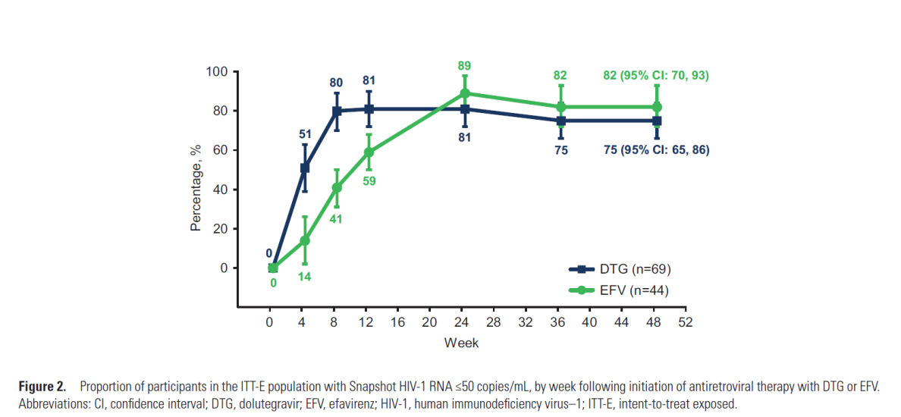
Alternatives to efavirenz in HIV/TB co-infection
Alternatives to Efavirenz (EFV)-based regimens are needed for patients co-infected with HIV and tuberculosis (HIV/TB) : CNS tolerance and drug resistance to NNRTIs
Integrase inhibitors (INSTIs) have been assessed as alternatives
Dolutegravir (DTG) and raltegravir (RAL) PK show interaction with rifampin (RIF) is compensated when double dose of INSTI is used
INSPIRING study : phase 3b non comparative, randomized, open-label trial evaluating DTG 50mg bid vs EFV 600mg qd
Dooley KE et al. CID 2019
De Castro et al. 10th IAS conference. Mexico. Slides MOAB0101
3

Slide 4
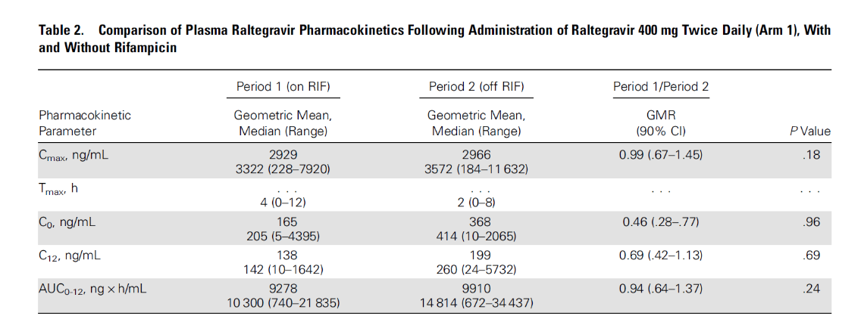
What is the appropriate dose of raltegravir?
Phase II: ANRS 12180 REFLATE TB
Evaluate efficacy and safety of RAL 400 mg bid, RAL 800 mg bid, or EFV 600 mg qd in TB/HIV patients on RIF containing TB treatment
Choice of the RAL dose: 400mg bid vs. 800mg bid
Similar proportion of patients with HIV RNA<50 copies/mL at W48
Drug-drug interaction (DDI) lower than that observed in healthy volunteers
Better tolerance profile : 2 patients experienced grade 3-4 hepatotoxicity in the RAL 800 mg bid
Pill burden and cost
Grinsztejn et al. Lancet HIV 2014
Taburet et al. CID 2015
4
De Castro et al. 10th IAS conference. Mexico. Slides MOAB0101

Slide 5
Study design
Phase III open label randomized non-inferiority multicenter trial
Brazil, Côte d’Ivoire, France, Mozambique, Vietnam
230 patients/arm (80% power, non-inf. margin -12%, one-sided α=2.5%)
Inclusion criteria
HIV1 infection
ART naïve
Confirmed or probable TB
Standard TB Tx ≤8 weeks
Exclusion criteria
HIV2 infection
TB meningitis
ALT >5ULN, Hb <6.5g/dL, Creat cl. <60mL/min
Pregnancy/breastfeeding
Primary endpoint
FDA snapshot
HIV-1 RNA < 50 copies/mL
HIV/TB co-infected adults on TB Tx
TDF /3TC qd + EFV 600 mg qd
1:1*
+ RAL 800 mg bid
TDF/3TC qd + RAL 400 mg bid
Screening (W-2)
W0
W24
W48
TB Treatment RHZE2/RH4
*Stratification by country
5
De Castro et al. 10th IAS conference. Mexico. Slides MOAB0101

Slide 6
Study flow chart
625 Screened
162 Not eligible
3 Eligible but not randomized
1 Death before randomisation
1 Withdrawal
1 Creat. clear. <60 ml/min
460 Randomized
230 EFV arm
230 RAL arm
1 HIV-1 RNA<50 copies/mL
2 HIV-2
2 HIV-1 RNA<50 copies/mL
1 ART not initiated
227 ITT set
230 Safety set
228 ITT set
229 Safety set
Study completed 203(88%)
Early termination of study 27 (12%)
- Death 14 (6%)
- LFU 10 (4%)
- Withdrawal 1 (0%)
- Transfer out 2 (1%)
Study completed 201 (87%)
Early termination of study 29 (13%)
- Death 12 (5%)
- LFU 10 (4%)
- Withdrawal 1 (0%)
- Transfer out 6 (3%)

Slide 7
Baseline characteristics (1)
 | EFV arm (n=227) | RAL arm (n=228)
Age (year) | 37 (30 - 43) | 34 (28 - 42)
BMI (Kg/m2) | 19.1 (17.5 - 20.8) | 19.1 (17.6 - 21.2)
Gender female | 90 (40%) | 90 (39%)
CD4 (cells/mm³) | 108 (35 - 238) | 98 (39 - 242)
CD4 < 50/mm³ | 77 (34%) | 75 (33%)
HIV RNA (Log10 copies/mL) | 5.5 (5.0 - 5.9) | 5.5 (5.0 - 5.8)
HIV RNA ≥100,000 copies/mL) | 164 (72%) | 172 (75%)
Time on TB treatment at enrolment | 20 (15 – 27) | 20 (15 – 28)
Cotrimoxazole prophylaxis | 201 (89%) | 199 (87%)
ALT (UI/L) | 23 (15 - 37) | 24 (15 - 39)
Creatinine clearance (mL/min) | 98 (77 - 118) | 103 (85 - 132)
Hemoglobin (g/dL) | 9.9 (8.2 - 11.4) | 9.8 (8.7 - 11.2)
HBs Ag positive | 21 (9%) | 24 (11%)
HCV Ab positive | 7 (3%) | 2 (1%)
Data are n(%) or median (IQR)
7
De Castro et al. 10th IAS conference. Mexico. Slides MOAB0101

Slide 8
Baseline characteristics (2)
 | EFV arm (n=227) | RAL arm (n=228)
Previous tuberculosis disease treated | 3 (1%) | 3 (1%)
Time on TB Tx at enrolment | 20 (15 – 27) | 20 (15 – 28)
Tuberculosis site of disease
Pulmonary | 159 (70%) | 152 (67%)
Extra-pulmonary | 43 (19%) | 44 (19%)
Pulmonary + extra-pulmonary | 25 (11%) | 32 (14%)
Bacteriological confirmation | 159 (70%) | 149 (65%)
Smear positive | 113 (50%) | 93 (41%)
Xpert MTB positive | 132 (58%) | 132 (58%)
MTB culture positive | 114 (50%) | 112 (49%)
Probable tuberculosis | 66 (29%) | 76 (33%)
LAM positive | 18 (8%) | 15 (7%)
Bacteriological confirmations or LAM+ | 177 (78%) | 164 (72%)
No bacteriological data | 2 (1%) | 3 (1%)
Data are n(%) or median (IQR)
8
De Castro et al. 10th IAS conference. Mexico. Slides MOAB0101

Slide 9
Efficacy outcome – W48
EFV arm
RAL arm
Treatment Difference (95% CI): RAL - EFV
Primary endpoint ITT :
HIV RNA<50 copies/mL at W48 (FDA snapshot)
-12% NI margin
-13.9
-5.1
3.7
Non-inferiority
criteria not met
-12
-8
-4
0
4
8
12
 | EFV arm (n=227) | RAL arm (n=228)
Virologic success (HIV-1 RNA<50 c/mL) | 150 (66%) | 139 (61%)
Virologic failure | 50 (22%) | 66 (29%)
HIV‑1 RNA ≥ 50 copies per mL in the window | 31 | 45
Discontinued Due to Lack of Efficacy | 9 | 13
Discontinued Due to Other Reasons and Last HIV-1 RNA ≥ 50 c/mL | 10 | 8
No data in the W48 window | 27 (12%) | 23 (10%)
Discontinued study/study drug due to AE or death* | 18 | 12
Discontinued study/study drug for other reasons | 7 | 11
On study but missing data in window | 2 | 0
9
De Castro et al. 10th IAS conference. Mexico. Slides MOAB0101

Slide 10
Efficacy outcome by baseline characteristics – W48
Primary endpoint ITT : HIV RNA<50 copies/mL at W48 (FDA snapshot)
10

Slide 11
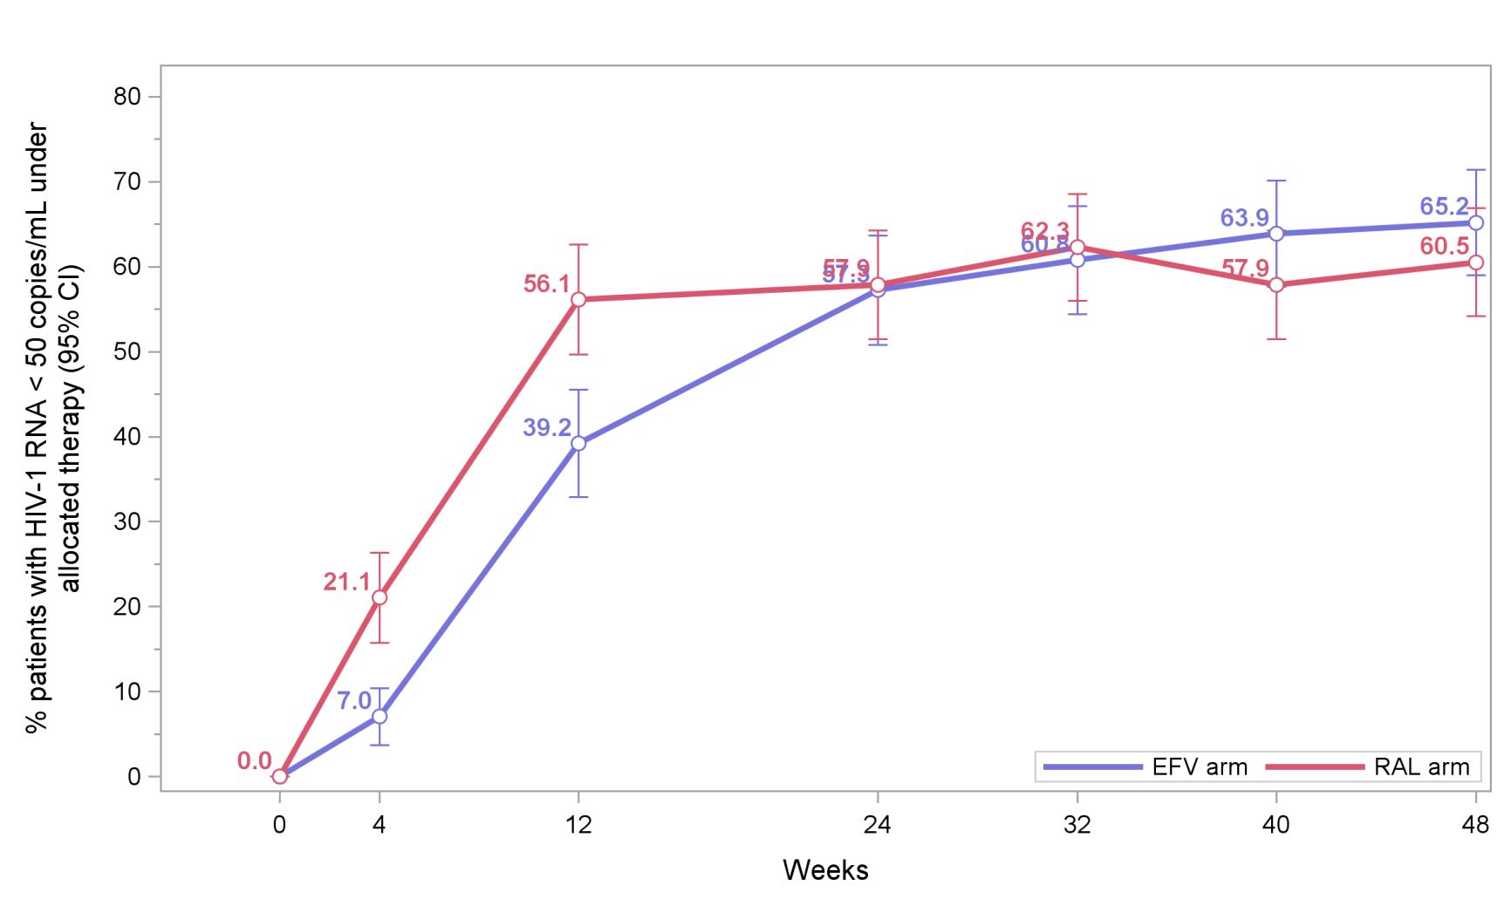
HIV RNA<50 copies/mL under allocated therapy - ITT
EFV 57.3% (95% IC 50.8-63.7)
RAL 57.9% (95% IC 51.5-64.3)
10
De Castro et al. 10th IAS conference. Mexico. Slides MOAB0101

Slide 12
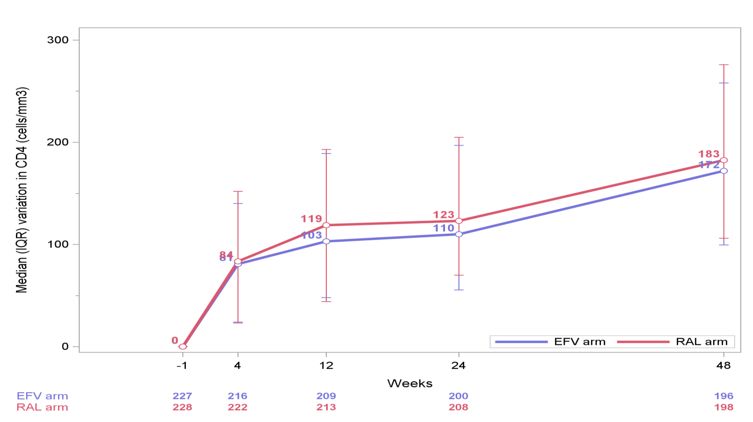
Median CD4 counts gain - ITT
11
De Castro et al. 10th IAS conference. Mexico. Slides MOAB0101

Slide 13
Adverse events through W48
 | Efavirenz (N=230) |  | Raltegravir (N=229)
Any AE, N AE, n patient (%) | 1038 | 208 (90%) | 950 | 207 (90%)
Grade 3 or 4 AEs, N AE, n patient (%) | 90 | 68 (30%) | 70 | 62 (27%)
Grade 3 | 57 | 41 (18%) | 50 | 42 (18%)
Grade 4 | 33 | 27 ( 12%) | 20 | 20 ( 9%)
Type of grade 3-4 AE, N AE, n patient (%)
Drug-related AE | 26 | 22 (10%) | 25 | 25 (11%)
ART discontinuation due to drug-related AE | 3 | 3(<1%) | 1 | 1 (<1%)
IRIS | 13 | 13 (6%) | 10 | 10 (4%)
Hepatotoxicity | 9 | 9 (4%) | 9 | 9 ( 4%)
Hypersensitivity | 1 | 1 (1%) | 1 | 1 (<1%)
Renal failure | 4 | 4 ( 2%) | 0 | 0 ( 0%)
12
De Castro et al. 10th IAS conference. Mexico. Slides MOAB0101

Slide 14
Conclusion
This study is the first large phase III randomized trial comparing efavirenz to INSTI-based ART in the context of HIV-TB co-infection
Despite promising virological and PK data from our previous phase II study we failed to demonstrate the non-inferiority of raltegravir 400 mg bid when compared to efavirenz 600mg qd at W48
Risk factors for virological failure are being analyzed
Based on these results, efavirenz should still be considered as the preferred first line therapy for HIV/TB co-infected patients
Raltegravir 400 mg bid may represent an alternative in selected patients
13
De Castro et al. 10th IAS conference. Mexico. Slides MOAB0101

Slide 15
Funding and aknowledgements
The trial is sponsored and funded by ANRS
This trial is co-funded in Brazil by the Ministry of Health, Brazil.
This trial is supported and co-funded by Merck and Co.
Aknowledgements
Participants for their participation and their commitment
National TB and HIV programs from participating countries for their support
Scientific Committee and Independent Data Monitoring Committee members
ANRS team: C. Rekacewicz, M. de Solère, A. Montoyo
ANRS 12300 REFLATE TB 2 Study Group
Brasil | Côte d’Ivoire | France | Mozambique | Vietnam
B. Grinsztejn V. Veloso R. Escada S. Wagner | E. Messou S. Eholié JB. Ntakpé DA.Diomandé | N. de Castro JM. Molina C. Delaugerre O. Marcy X. Anglaret C. Chazallon | N. Bhatt C. Khosa I. Timana D. Nhumaio | G. Do Chau B. Nguyen D. Laureillard D. Rapoud A. Domergue
Programme PAC-CI
14
De Castro et al. 10th IAS conference. Mexico. Slides MOAB0101

